Slide 1
J V Technologies
VARAIBLE SYNTAX
NA

Slide 2

J V Technologies
COMPLETE SYNTAX
Name

Slide 3
J V Technologies
DATA SYNTAX
=

Slide 4
J V Technologies
COMPLETE SYNTAX
= 23
= “venkatesh”

Slide 5
J V Technologies
FUNCTION SYNTAX
def ( ) :

Slide 6
J V Technologies
COMPLETE SYNTAX
def Invitation( ) :
Variable’s Data

Slide 7
J V Technologies
SAMPLE CODE
1
Line1 def Invitation( ) :
Line2 house= “venkatesh”
2

Slide 8
J V Technologies
CLASS SYNTAX
class :

Slide 9
J V Technologies
COMPLETE SYNTAX
class hurting:
Variable’s Data

Slide 10
J V Technologies
SAMPLE CODE
1
Line1 class Hurting:
teasing= “rama”
Hurting.teasing
2

Slide 11
J V Technologies
OBJECT SYNTAX
= ( )
customer Product

Slide 12
J V Technologies
COMPLETE SYNTAX
Line1 class Hurting:
Line2 teasing= “venkatesh”
Pallavi = Hurting( )

Slide 13
J V Technologies
FUNCTION CALL SYNTAX
( )
FunctionName

Slide 14
J V Technologies
COMPLETE SYNTAX
Line1 def Python( ) :
Line2 Name = “venkatesh”
Python( )

Slide 15
J V Technologies
SAMPLE CODE
1
Design def Python( ) :
Line2 Name = “venkatesh”
PFE Python( )
2
1

Slide 16
J V Technologies
VALIDATION SYNTAX
if == :
Symbol

Slide 17
J V Technologies
COMPLETE SYNTAX
if ( Variable Symbol Data ):
if name == “venkatesh” :

Slide 18
J V Technologies
SAMPLE CODE
Line1 def Python( Name , Age ) :
if ( Name == “python“ ) :
Code..
if ( isinstance( Name ,str ) ) :
Code..
else :
Code..

Slide 19
J V Technologies
FUNCTION WITH VARIABLE SYNTAX
def ( , ) :

Slide 20
J V Technologies
COMPLETE SYNTAX
def Python( Name , Age ) :
Variable’s Data

Slide 21
J V Technologies
SAMPLE CODE
Line1 def Python( Name , Age ) :
if( Name == “Python” ) :
print ( Name )
else :
print(“invalid name”)
Line6 Python( “python” , 20 )
1
1

Slide 22
J V Technologies
RETURN SYNTAX
return

Slide 23
J V Technologies
COMPLETE SYNTAX
return 0
return name
Variable’s / Data

Slide 24
J V Technologies
SAMPLE CODE
Line1 def Python( Name , Age ) :
if( Name != “Python” ) :
return -1 Line 7 ret
else :
print ( Name )
return 0
Line7 ret =Python( “cython” , 20 )
ret => -1
1
1

Slide 25
J V Technologies
METHOD SYNTAX
def ( self ):

Slide 26
J V Technologies
COMPLETE SYNTAX
class jvt :
def __init__( self ):
Variable’s Data

Slide 27
J V Technologies
SELF SYNTAX
def ( self ):
self.

Slide 28
J V Technologies
COMPLETE SYNTAX
class jvt :
def __init__( self ):
self.
Variable’s

Slide 29
J V Technologies
SELF WITH VARAIBLE SYNTAX
def ( self ):
self.name

Slide 30
J V Technologies
COMPLETE SYNTAX
class jvt :
def __init__( self ):
self.name
Variable’s

Slide 31
J V Technologies
SELF WITH VARAIBLE AND DATA SYNTAX
def ( self ):
self.name =

Slide 32
J V Technologies
COMPLETE SYNTAX
class jvt :
def __init__( self ):
self.name = “ venkatesh“
Rama = jvt( )

Slide 33
J V Technologies
SELF CAN READ VARAIBLE
def ( self ):
print( self.name )

Slide 34
J V Technologies
COMPLETE SYNTAX
class jvt :
def __init__( self ):
self.name = “ venkatesh“
def dis( self ):
print( self.name)
Rama = jvt( )
Rama.dis()

Slide 35
J V Technologies
COMPLETE SYNTAX
class jvt :
def __init__( self ):
self.name = “ venkatesh“
def __del__( self ):
print( self.name)
obj = jvt( )
del obj

Slide 36
J V Technologies
VARIABLE IN CLASS SYNTAX
ClassName . VariableName

Slide 37
J V Technologies
COMPLETE SYNTAX
class Python :
Name = “venkatesh”
Python.Name

Slide 38
J V Technologies
CLASS WITH VARIABLE CODE
1
Line1 class Python :
Name = “venkatesh”
def dis( self):
print( Python.Name )
obj =Python ( )
obj.dis()
2

Slide 39
J V Technologies
SELF WITH ARGUMENTS
def ( self , ):
self.name =

Slide 40
J V Technologies
COMPLETE SYNTAX
class jvt :
def __init__( self , n):
self.name = n
bond= jvt ( “venkatesh” )

Slide 41
J V Technologies
METHOD CALL SYNTAX
. ( )

Slide 42
J V Technologies
COMPLETE SYNTAX
bond. dis( )

Slide 43
J V Technologies
STATIC METHOD SYNTAX
@staticmethod
def ( ):

Slide 44
J V Technologies
COMPLETE SYNTAX
class jvt:
name = “venkatesh”
@staticmethod
def staticmethod( ):
print( jvt.name )
jvt.staticmethod( )

Slide 45
J V Technologies
ENCAPULSATION SYNTAX
__
self. __
_

Slide 46
J V Technologies
COMPLETE SYNTAX
__Name
_
self. __Name

Slide 47
J V Technologies
COMPLETE SYNTAX
class jvt :
_gst = 18.0
def __init__( self ):
self.__name
self.age
obj = jvt ( )
obj.__gst // ERROR

Slide 48
J V Technologies
INHERITANCE SYNTAX
class ( ) :

Slide 49
J V Technologies
COMPLETE SYNTAX
class Python( Jvt ):
Python => Variable in method __init__( )
Jvt
Allocate memory
for both class variable in method

Slide 50
J V Technologies
SAMPLE CODE
class Python( jvt ):
def __init__( self , n , a):
self.age = a
obj = Python( “jv technologies”, 8 )

Slide 51
J V Technologies
INHERITANCE SUPER SYNTAX
. __init__ ( self , )

Slide 52
J V Technologies
COMPLETE SYNTAX
jvt . __init__ ( self , )

Slide 53
J V Technologies
SAMPLE CODE
class Python( jvt ):
def __init__( self , n , a):
jvt . __init__ ( self , n )
self.age = a
obj = Python( “jv technologies”, 8 )

Slide 54
J V Technologies
SELF WITH VARAIBLE LIST SYNTAX
def ( self ):
self.name = [ ]

Slide 55
J V Technologies
COMPLETE SYNTAX
class Python :
def __init__( self , arg):
self.arr = [ ]
self.arr .append( arg )

Slide 56
J V Technologies
RAISE SYNTAX
raise (“ “ )

Slide 57
J V Technologies
COMPLETE SYNTAX
raise TypeError("name type is invalid")

Slide 58
J V Technologies
SAMPLE CODE
1
Line1 def Python( Name , Age ) :
if( Name != “Python” ) :
raise TypeError("name type is invalid")
else :
print ( Name )
return 0
Line7 Python( “cython” , 20 )
1

Slide 59
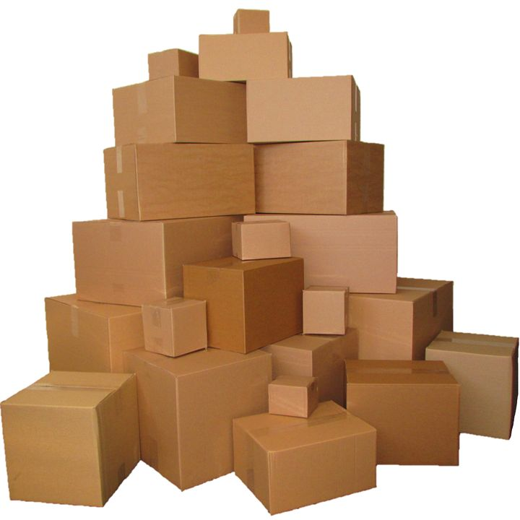
J V Technologies
PACKAGE
Package has set of python file’s which are implemented using
7 principle’s
import keyword.
import can locate folder or file in harddisk

Slide 60


J V Technologies
PACKAGE
FOLDERS
import
.py FILES
From

Slide 61
J V Technologies
LIBRARY PACKAGE
import json
Tells intreperter this program needs .py file’s( functions, class from) the folder json.

Slide 62
J V Technologies
LIBRARY PACKAGE
from json import decoder
Tells intreperter this program needs .py decoder ( functions, class from) the folder json.

Slide 63
J V Technologies
LIBRARY PACKAGE
from json import decoder
decoder .py file ( functions, class )
we can allocate the memory
decoder.JSONDecoder
class 'json.decoder.JSONDecoder
obj = decoder.JSONDecoder()

Slide 64
J V Technologies
LIBRARY PACKAGE
import abc
Tells intreperter this program needs .py abc( functions, class from).

Slide 65
J V Technologies
__init__ .py
from .EXAMPLE2 import *
from .EXAMPLE3 import file
Tells intreperter this file needs .py EXAMPLE2( functions, class ) ,EXAMPLE3 file class .

Slide 66
J V Technologies
DATASTRUCTURE MEMORY INDEX SYNTAX
for in :

Slide 67
J V Technologies
DATASTRUCTURE MEMORY INDEX SYNTAX
[ 1, 2 , 3 , 4 , 5 ]
0 1 2 3 4
count =0
for variable in datastructureobject :
5 time’s
after excuting the code afer : the next index is read to the variable

Slide 68
J V Technologies
DATASTRUCTURE MEMORY INDEX SYNTAX
[ 1, 2 , 3 , 4 , 5 ]
0 1 2 3 4
count =0
for variable in datastructureobject : # Line 1
if variable == 4 : # Line 2
count =count +1
# Line 1

Slide 69
J V Technologies
DATASTRUCTURE MEMORY INDEX SYNTAX
[ 1, 2 , 3 , 4 , 5 ]
0 1 2 3 4
count =0
# first index value 1
for variable in datastructureobject :
if variable == 4 :
count =count +1
After excuting the code below : symbol next index value is read

Slide 70
J V Technologies
DATASTRUCTURE SAMPLE CODE
count =0
for variable in datastructureobject : #Line1
if variable == 4 :
count =count +1
else :
continue #Line 1

Slide 71
J V Technologies
CLASS OBJECT WITH ARG FUNCTION ,DS OBJECT SYNTAX
= ( lambda : , [ ] )

Slide 72
J V Technologies
COMPLETE SYNTAX
obj = map ( lambda : , [ 1 , 2, 3 , 4] )
def ( ): => lambda

Slide 73
J V Technologies
SAMPLE CODE
obj = map ( lambda x :x==2, [ 1 , 2, 3 , 4] )
def ( x ): => lambda x :
for i in obj:
print(i)

Slide 74
J V Technologies
FUNCTION ARD DATA TYPE SYNTAX
def Python( Name :str , Age:[] ) :
Variable’s Data

Slide 75
J V Technologies
SAMPLE CODE
1
Line1 def Python( Name:str , Age:[] ) :
if( Name == “Python” ) :
print ( Name )
else :
raise ValueError(“value error” )
Line6 Python( “python” , [ 1,2,3] )
1

Slide 76
J V Technologies
ACESS SPECIFIER SYNTAX
_Name Protected
__age Private
exp Public

Slide 77
J V Technologies
METHODS NAMING SYNTAX
def __ __ ( self ) :

Slide 78
J V Technologies
SAMPLE CODE
class jvt:
def __ init __ ( self ) :
def __ add __ ( self ) :
def __ del __ ( self ) :
def display ( self ) :

Slide 79
J V Technologies
CALLING METHODS SYNTAX
Object . MethodName( )
jvt ( ) => init
del object => del
object + object1 => add

Slide 80
J V Technologies
INHERITED METHODS CALLING SYNTAX
Snake.__del__(self)
super().__init__(snack,special)

Slide 81
J V Technologies
OOPS CODE
class jvt:
( ) def __ init __ ( self ) :
+ def __ add __ ( self ) :
del def __ del __ ( self ) :
.( ) def append ( self ) :
.( ) def push ( self ) :
.( ) def pop ( self ) :

Slide 82
J V Technologies
OOPS CODE
class jvt:
obj def __ repr __( self ) :
str( obj ) def __str__(self):
print( obj )

Slide 83
J V Technologies
EXCEPTION SYNTAX
try :
except :

Slide 84
J V Technologies
EXCEPTION SYNTAX
assert ( == )

Slide 85
J V Technologies
SAMPLE CODE
def jvt( a ):
assert( a == None)
print("hello jvt")
jvt( 1 )
assert( a == None)
AssertionError

Slide 86
J V Technologies
TUPLE SYNTAX
( )

Slide 87
J V Technologies
COMPLETE SYNTAX
obj = ( 1, 2 ,3 )

Slide 88
J V Technologies
LIST SYNTAX
[ ]

Slide 89
J V Technologies
COMPLETE SYNTAX
obj = [ 1, 2 ,3 ]

Slide 90
J V Technologies
DICT SYNTAX
{ }

Slide 91
J V Technologies
COMPLETE SYNTAX
obj = { “c” :1, “cpp”: 2 , “java”:3 }

Slide 92
J V Technologies
FUNCTION SYNTAX
def ( ):
def ( ):
return

Slide 93
J V Technologies
COMPLETE SYNTAX
def is( ):
def u( ):
return u

Slide 94
J V Technologies
FUNCTION SYNTAX
def ( ):
yield

